Slide 1
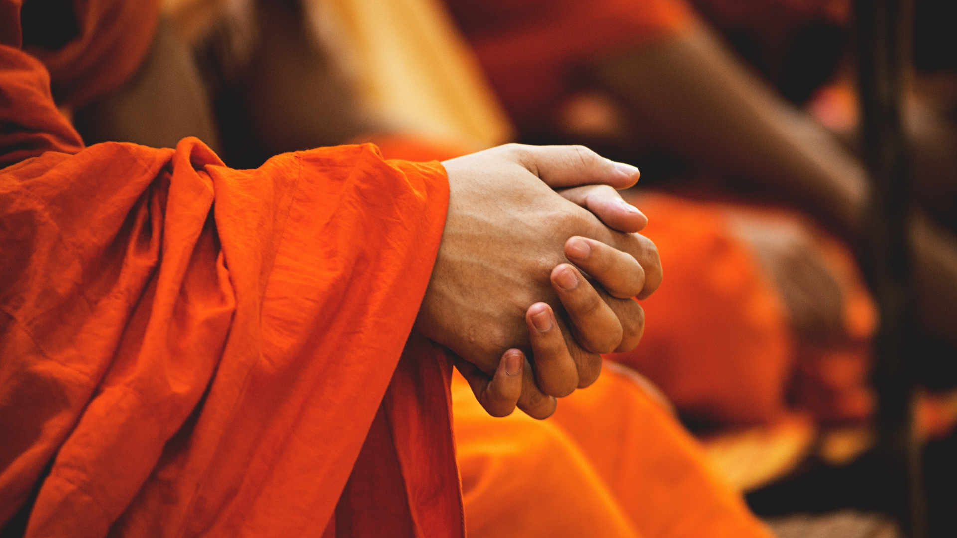
What Is Buddhism?

Slide 2
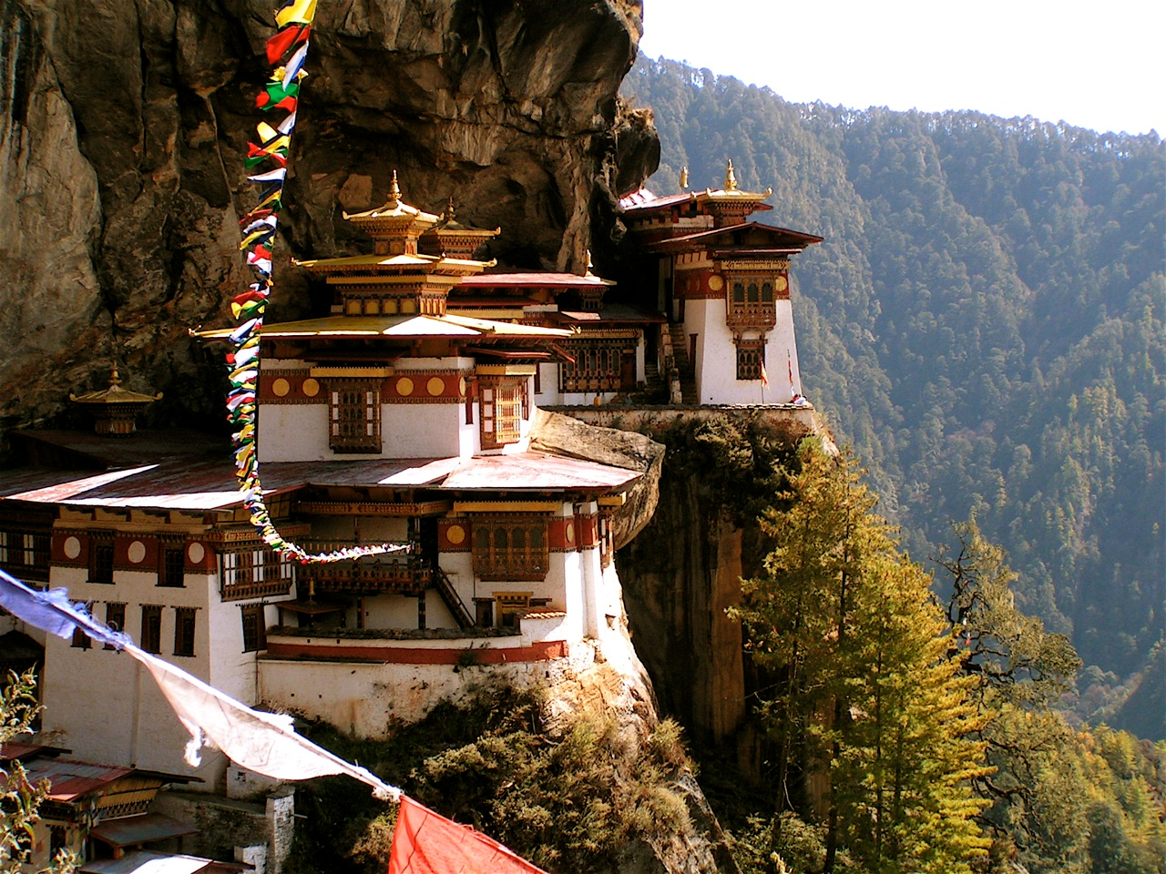
Buddhism is a way of life
The Buddha taught that having the right way of life could make you very happy.
Buddhism is also a religion
In many Buddhist countries, there are temples and monasteries, and people read sacred texts and even pray to gods.

Slide 3
Where Does It Come From?

Slide 4
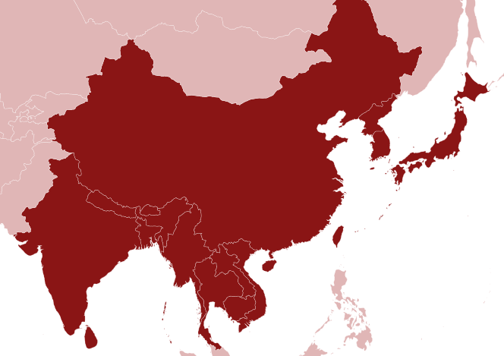
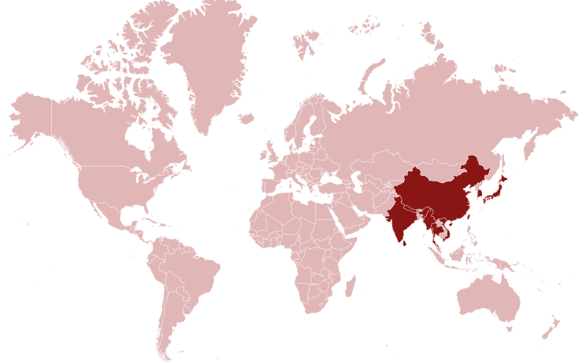
The Buddha was born in Nepal, but he became enlightened in India after travelling for many years.
He had lots of followers during his life, and after he died Buddhism spread to China.
Then from China, it travelled to Japan, Southeast Asia, and the mountains of Tibet.
These are the Buddhist homelands.
Tibet
China
Japan
Nepal
India
Southeast
Asia

Slide 5
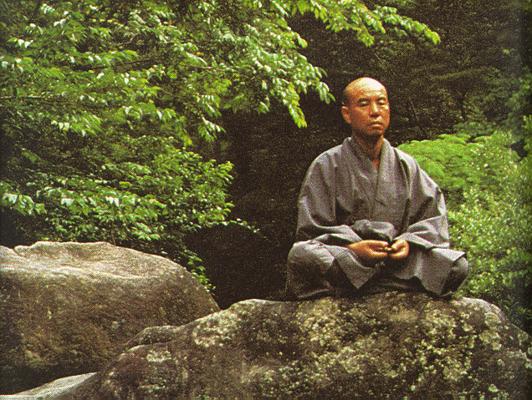
Buddhism is slightly different in all of these countries.
Zen Buddhism comes from China and Japan.
Zen Buddhists focus on meditation and helping people.

Slide 6
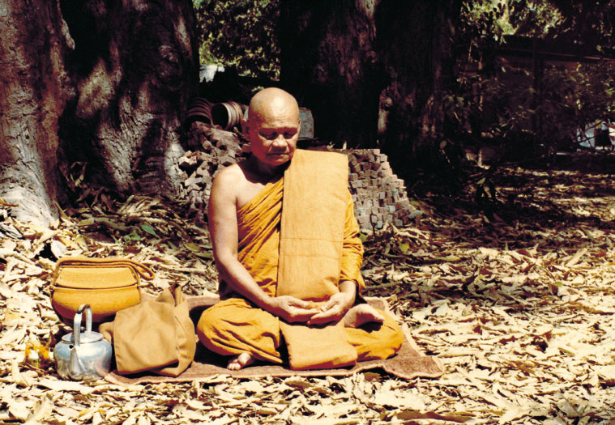
Buddhism in Southeast Asia focuses on mindfulness and reading about the Buddha.

Slide 7
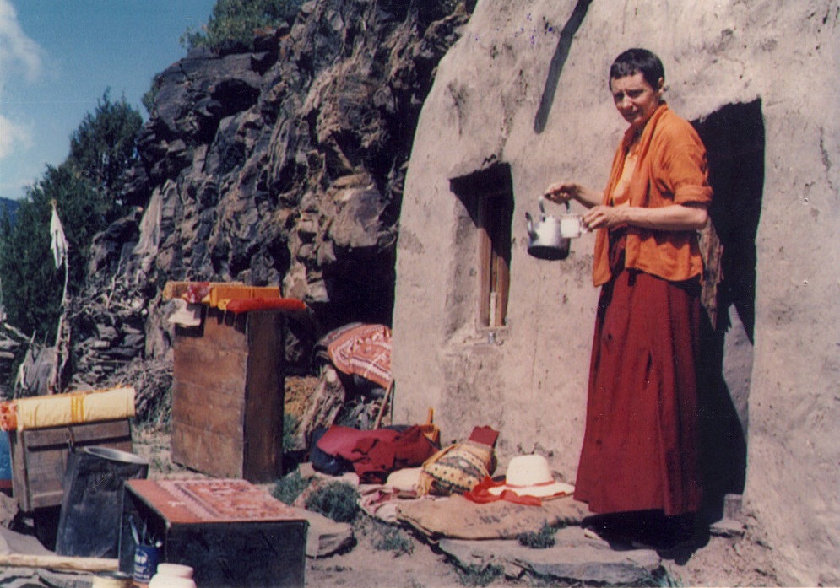
Tibetan Buddhism focuses on achieving enlightenment as fast as possible. Some Tibetan Buddhists will meditate for years in mountain caves, like this British woman, Diane Perry.
Diane became a Buddhist nun and meditated in this cave for 12 years. This is called a retreat. Lots of Buddhists go on retreats, but they usually only last for one or two weeks.

Slide 8
What Do Buddhists Do?

Slide 9
The most serious Buddhists become monks or nuns and live together in monasteries, meditating, studying, and helping people.
Lay Buddhists have more ordinary lives, but they still meditate, read Buddhist books, and visit Buddhist centres to learn more.

Slide 10
What Is Buddhist Meditation?

Slide 11
Buddhists are not the only people who meditate. People from lots of different religions meditate, in lots of different ways.
The Prophet Muhammad meditated before he wrote the Qur’an.
We’ll talk about two kinds of Buddhist meditation:
Mindful breathing
And loving-kindness.
All kinds of meditation are relaxing and help you to concentrate better.

Slide 12
Mindful breathing is very simple. Just close your eyes and pay attention to your breath.
What parts of your body move when you breathe?
How deep are your breaths?
How fast or slow are you breathing?
This is the most common Buddhist meditation in the world.

Slide 13
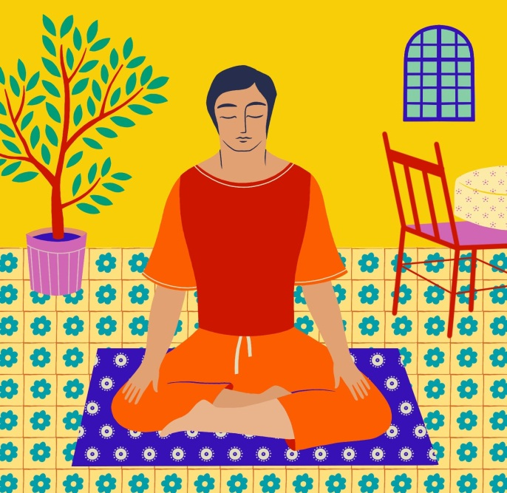
Loving-kindness meditation is also quite simple.
First, close your eyes and say to yourself, “May I be happy.”
Then think of your best friend and say, “May you be happy, too.”
Then imagine your worst enemy, someone who isn’t very nice to you, and say the same thing to them: “May you be happy.”
The Buddha taught this kind of meditation to help people get on with each other.

Slide 14
Do You Have Any Other Questions?

